Slide 1

Cleantech to Market (C2M) Spring 2011
Developing Successful Products January 31, 2011
Haas School of Business, UC Berkeley

Slide 2
T2M Cycle
Innovation
Partnership
Commercialization Strategy
Market assessment
Product Realization
Path-finding
Risks & priorities

Slide 3
Innovation Through Partnership
Often innovation is inspired by a perceived market application opportunity*
An existing unfulfilled need or an emerging customer creation opportunity
Innovation Partnership
* Lead User Innovation is an exception

Slide 4
Commercialization Strategy
Exploration of market and business model opportunities
Characteristics of markets, users and stakeholders
Market asset structure
The requirements for application of technology to market context
Commercialization Strategy

Slide 5

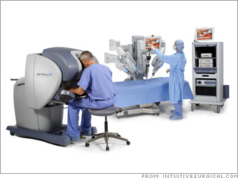
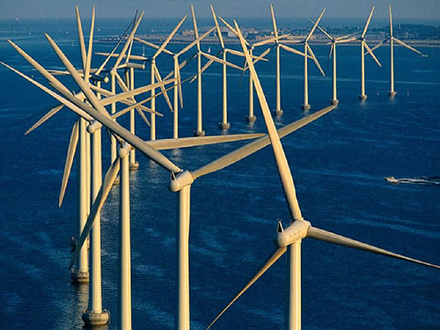


Market opportunities are realized through a product

Slide 6
Successful Products
Match technology to the needs and wants of product stakeholders in the market-space and in the application (use) environment
Create compelling & differentiated value experience
Attributes of successful products:
Serve an attractive market
Profitable
Competitive advantage
Accessible (channels)
Manufacturable
Serviceable
Concurrent with complementary products
Sustainable

Slide 7
Who are the stakeholders?
The firm (its strategic objectives & constraints)
Shareholders
Customers (end users)
Channel players
Manufacturing operation
Supply-chain partners
Employees
Society
Natural environment
Natural Environment
Suppliers
Partners
Alliances
Inbound Logistics
Firm
Products & Services
Intermediaries
Shareholders
Employees
Outbound Logistics
End Users
Flow of products
& services
Flow of
Information
Society
(local, global)

Slide 8
C2M & Technology-to-Market Cycle
Commercial
Sales
C2M
Basic
Research
Proof of
Concept
Stage of Development
Net Cash Flow
Prototype
Product
Definition
Product
Prototype and
Business Plan
Early adopters
Demonstration
Βeta unit and
Revised
Business Plan
Product
Introduction
Based on a graphic produced by Ben Finkelor, CleanStart
Representative and not to scale
Notes:
Based on a graphic produced by Ben Finkelor, CleanStart

Slide 9
Product Development & Commercialization Process
Market Segment Analysis
User Need Research
R&D
- Business Model
Prod Dev Proposal, Phase 0
Customer development, Prototyping
MRS
Phase 1 Concept
Exploration & Feasibility
ERS
Phase 2
Project Planning
Phase 3 (Alpha)
Product Design Development & Characterization
Phase 4 (Beta)
Manufacturing & Customer Qualification
Product Release to Market

Slide 10
Product Development Funnel
Technology & Market Changes
Market &
competitor
assessment
Identification
of customer /
stakeholder
needs/values
Concept
Development
Product & Process Design
Launch
Technology
assessment
Creativity / Flexibility
Discipline & Control

Slide 11
Product Realization Path-finding
Pathfinding hones the direction of research, product concept, and product platform
Deep dive iterative process of matching technology to market context:
Understand customers/users, use environment and validate the product concepts
Bi-directional evolution in emerging markets and applications where user needs are not established
Product Path Finding

Slide 12
C2M Case Study Photovoltaic (PV) Technology to Market

Slide 13
Copper Indium Gallium diSelenide – CIGS Solar Cell Structure
-
Fingers
Ag-Al
AR Coating
ZnO
n
CdS
Cu(In,Ga)Se₂
p
Contact (Mo)
Substrate
+

Slide 14
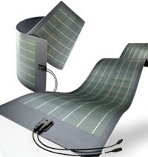
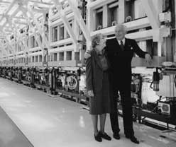
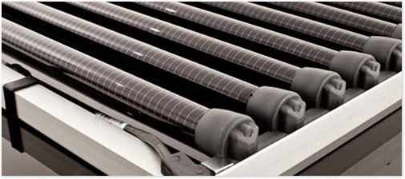
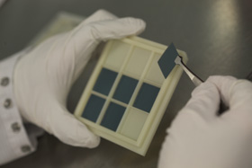
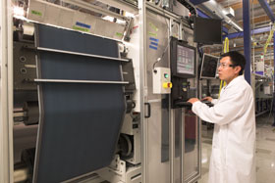

PV Cells to Final Products
30 MW machine which is longer than a football field
R&D
Printing Solar Cells

Slide 15
PV Tech-to-Market Path
Basis of competition
Efficiency, W/m²
Cost, $/W
Wholesale energy, $/kWh
Retail (peak) energy, $/kWh
Manufacturing Process & Equipment
Technology
Eff. =14%
Flexible Substrate
Tubular
Flat rigid
Consumer Electronics, Communication
Residential, Commercial
Utility Scale
OEM
Bldg owners, Construction companies
Utilities
Sputtering / Evaporation (PVD)
Electroplating
Printing
CIGS PV Technology
Physics
1 cm² samples
20% eff
Lab
Scale
Volume Production Scale
Product Design
Market Segment
Raw Material
Technology / Availability
Complementary Products / Technologies
Encapsulation, Packaging
Complementary Products / Technologies
Inverter
Smart grid
Installation

Slide 16
CleanTech-to-Market Path
Identify the critical factors that drive the technical and commercial feasibility of C2M

Slide 17
Product Realization Path-finding Exploration & Feasibility
Technical and commercial feasibility of alternate application scenarios and design concepts is essential before investment in product development.
Multitude of market opportunities and applications, and technological & market uncertainties require risk assessment and priority setting.

Slide 18
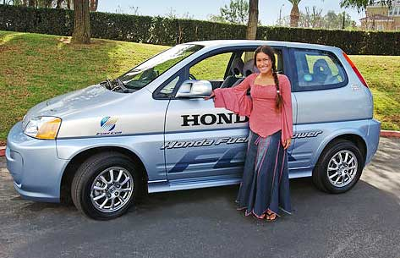


Complementary Technologies & Products
Technologies and products that users must have to make your product fulfill their needs and meet the intended functions
Concurrent development of complementary products
Honda FCX Hydrogen Fuel Cell Concept Car

Slide 19
Thank You!

